Slide 1
Android Programming Class: Graduate Term Project – Team 1
Marcos Davila
Marcus Silveira
Prince Oladimeji
Members:

Slide 2
Agenda
Recap
Demo
Implementation Analysis
Technology
Extras
Challenges

Slide 3
Recap: Project Overview
Project Name: Sheep Herder
This project consists of a game where the user controls a dog, the “Sheep Herder”, and is responsible for keeping the sheep together, avoiding the perils of the dangerous fox that can come at any time.

Slide 4
Recap: Description of the Project
Characters Definition
Sheep
Is not allowed to go off the screen
They can go in any direction, and move by reaction to dog’s or fox’s proximity
They are slower than the other animals
Dog
Keeps the sheep safe
Chases the predator away (fox)
Controlled by the user
Fox
Chases sheep to eat them
Runs away from the dog
Appears on the game at random

Slide 5
Recap: Description of the Project
Project Features
Representation of each animal and its characteristics
Full screen game with independent rendering (for each set of animals)
User has full control over the dog
Artificial Intelligence for Fox and Sheep to move and react
Three main screens: home screen, settings, and game screen
Ability to control speed of animals (by default: fox’s speed > dog’s > sheep’s)

Slide 6
Recap: Description of the Project
Technical Details
Android application that doesn’t need to contact any external service
Implementation of SurfaceView to render in full screen mode
Use of fragments to render top bar with “Back” option
Use of multiple types of UI widgets, including buttons, images, seek bars, and textViews
Use of SharedPreferences to store information among screens
Internationalization (support for Spanish)
Unit and integration tests will use Android Junit Tests / Robotium

Slide 7
Recap: Project Design and Navigation
A white round figure will represent a sheep
A green square figure will represent the dog
A red triangular figure would represent a fox
Users can touch the screen on the corners to represent where they want the dog to move (for example, tap anywhere up to move the dog upwards).

Slide 8
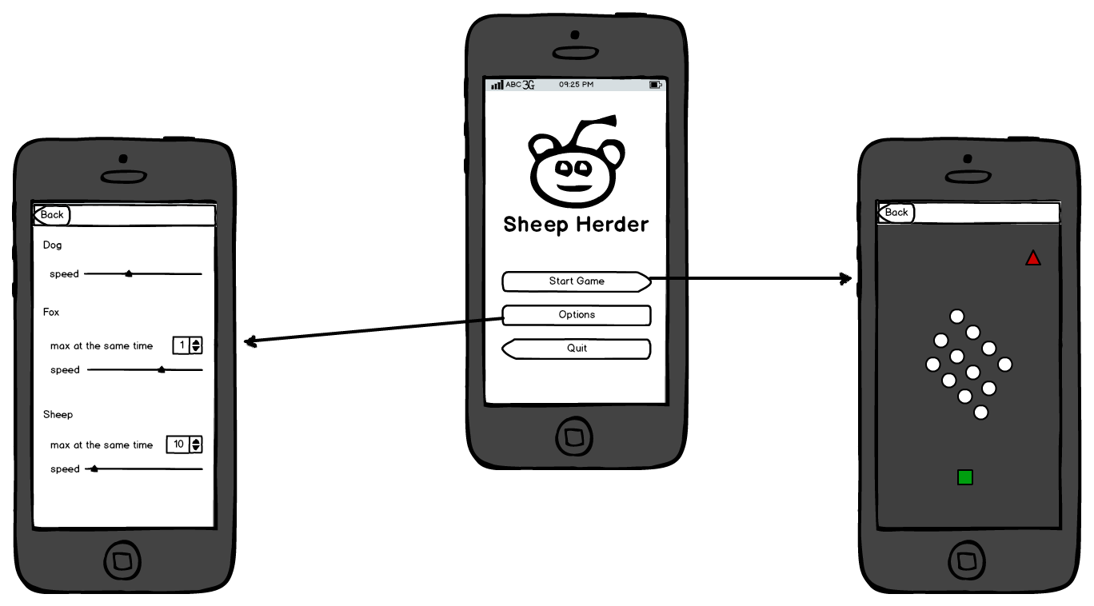
Recap: Project Design and Navigation

Slide 9
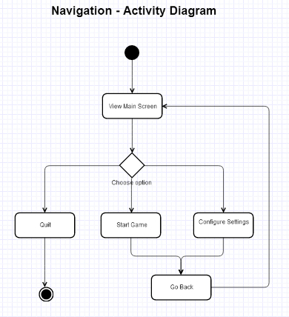
Recap: Project Design and Navigation

Slide 10
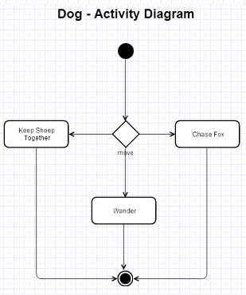
Recap: Project Design and Navigation

Slide 11
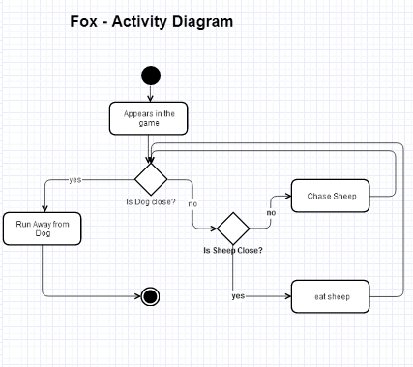
Recap: Project Design and Navigation

Slide 12
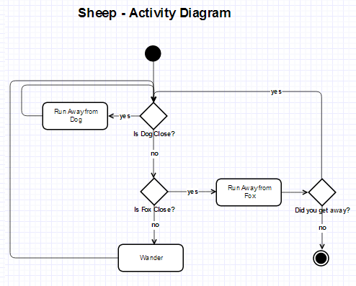
Recap: Project Design and Navigation

Slide 13
Demo

Slide 14
Implementation Analysis
Sheep must remain within the dog’s proximity | Goal achieved
Sheep can go in the direction (up, down, left, right) | Goal achieved
Sheep not allowed to go out of sight | Goal Achieved
Dog can herd sheep by getting close to them | Goal Achieved
Dog to chase the predator (fox) away | Goal Achieved
Dog to be Controlled by either touch screen / keyboard | Goal Achieved
Fox can run toward a sheep and eat it | Goal Achieved
Fox runs away from dog | Goal Achieved

Slide 15
Technology
Features | Tools
The surface | SurfaceView Threading
Game settings | SeekBar RadioGroup ScrollView
The Timer | Java Timer API
Layouts | Linear, Relative, and combination
Unit and Integration Testing | Robotium for Integration Tests Junit for Unit Tests
Ads | Google Play Services – AdMob
Internationalization | Support for Spanish and English (strings.xml)
Data Storage | SharedPreferences

Slide 16
Extras
Icons/Images instead of shapes
Background image for the game
Sheep in danger logic (x)
Eating time delay (freeze)
Timer & Score system
Tracking Highest Score
Interstitial modals for Game Start and Game Over
Google Ads

Slide 17
Challenges
Adding logic to start game elements in different positions
Collision Detection (dog – fox, fox – sheep)
Java Timer API instead of Countdown API (cancelling)
Managing Threads, knowing when game is finished (no sheep or time over)
Layout Alignment, including Ads
Different Screen Sizes – Adjustable layouts
Interstitial modals and actions
Google Ads
Performance Issues
Gestures / Long Click

Slide 18
Bonus

Slide 19
QA

Slide 20
Thank you for listening!

